Slide 1

Static Website Hosting on AWS
Serverless Framework for Python Data Analysis and Visualization, using Flask API
Cole Bromfield, Mamadou Ndiong, Dennis Reyes

Slide 2

Dataset Background
Multiple datasets containing pitching and hitting statistics, player and manager information, and more
Covers entirety of MLB history, from 1871 to present day (over 150 years worth of data)
Available in CSV format, SQL, R, and more
This Photo by Unknown Author is licensed under CC BY-SA

Slide 4
Problem
Anyone with moderate programming skills in Python, SQL, or R can easily take advantage of the vast array of knowledge available in these datasets
Challenging for those without programming skills—with thousands of entries, manual retrieval is complex and time-consuming

Slide 5
Solution
A static website allowing users to easily query and view player and team statistics and visualizations
Functionality
Generate leaders in a given pitching or batting statistic for a given year or period
Visualize the top n players in a given pitching or batting statistic for a given year or period

Slide 6

Backend Tools
Packages used: Pandas, NumPy, Flask
Python functions read Lahman datasets from .csv files
Visualization functions return JSON object with necessary information for visualization
Interaction between a React frontend and a Flask API backend via REST API requests and responses.
This Photo by Unknown Author is licensed under CC BY-SA

Slide 7


AWS Tools
API Gateway for REST API requests
Serverless Framework (integrated with React and Flask)
Lambda functions for backend handling
S3 for static website hosting
CloudFormation for CI/CD pipeline for deployment
This Photo by Unknown Author is licensed under CC BY-NC

Slide 8


Frontend Tools
Webpage developed in JavaScript with React
React components to build out visualization tool
Vite for application build for frontend
This Photo by Unknown Author is licensed under CC BY-NC
This Photo by Unknown Author is licensed under CC BY-SA

Slide 9
Implementation Demo

Slide 10
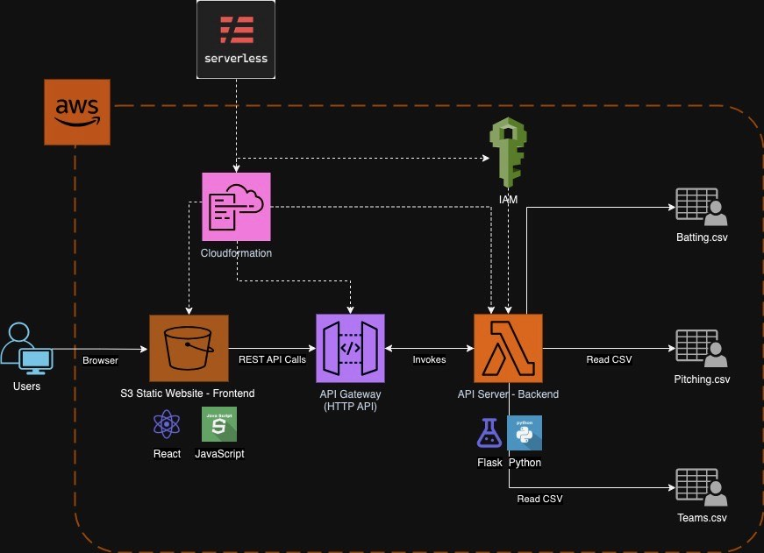

Slide 11
Performance Metrics
Initial HTTP request take a little longer than normal because of AWS Lambda cold start
Scalable as more HTTP requests come in, Lambda is able to scale out.

Slide 14
Limitations
Currently limited to specific lookups from three of the many Lahman datasets
Datasets are in static files and do not automatically update—to include data for 2024 season and beyond, files must be manually replaced
Data from prior to 1900 is unreliable and incomplete

Slide 15
Future Scope
Lahman datasets are updated yearly—framework can be modified to pull datasets directly from source, updating automatically
Expand functionality—additional functions providing further analysis and/or drawing from other (currently unused) Lahman MLB datasets
Further visualization functionality
Apply authorization and authentication for requests for backend

